Slide 1


LEAST SQUARE BASED IMAGE PROCESSING

Slide 2
Overview
Least square based image inpainting

Slide 3
1-D Missing Sample Estimation Problem Formulation

Slide 4
1-D Missing Sample Estimation Formulation

Slide 5
1-D Missing Sample Problem Estimation Formulation

Slide 6
1-D Missing Sample Estimation Formulation

Slide 7
1-D Missing Sample Estimation Problem Solution

Slide 8
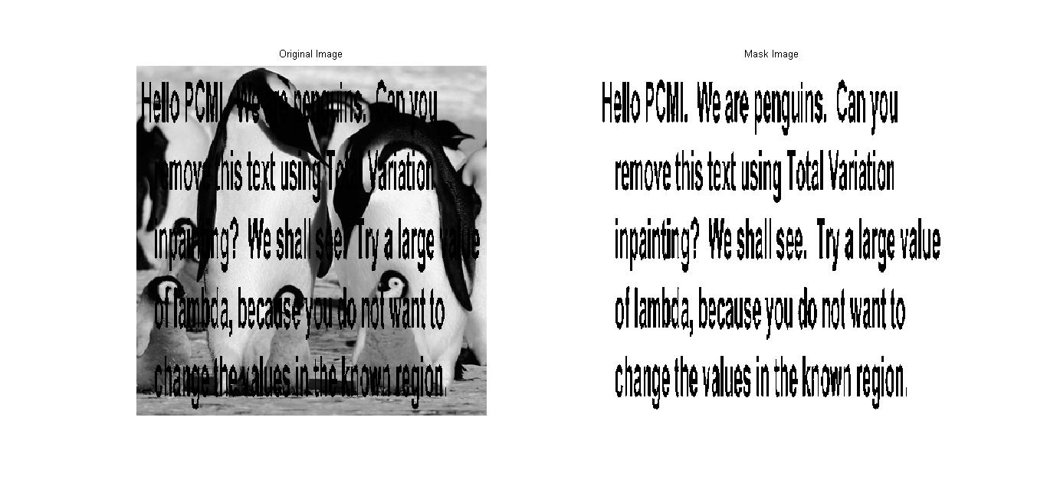
2-D Image Inpainting

Slide 9
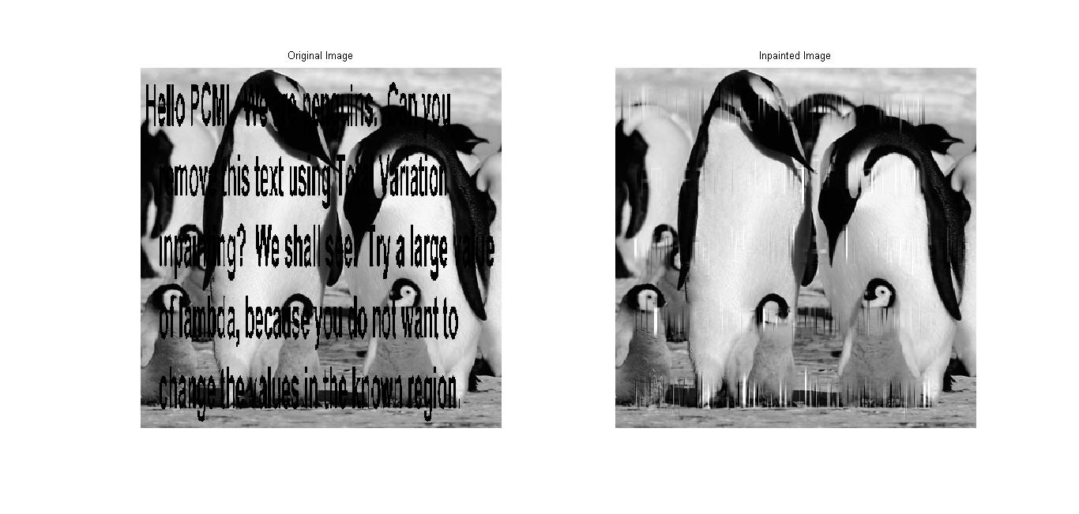
2-D Image Inpainting

Slide 10
Reference
“Least Squares with Examples in Signal Processing” – Ivan Selesnick, 2013.

